Slide 1
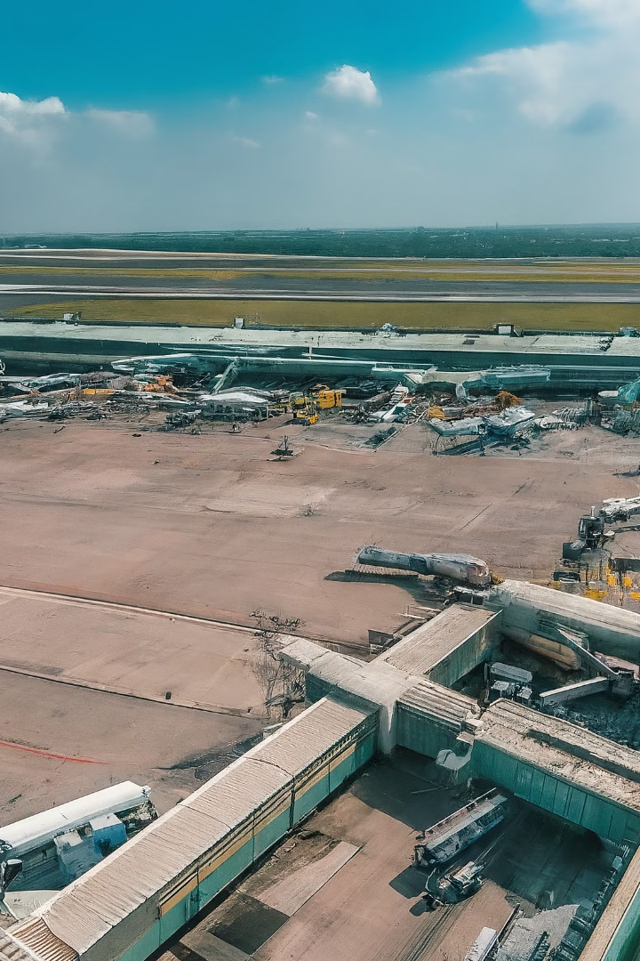
Statistical Measurement of Service Quality of Indian Domestic Airlines: A Customer Perspective
The Indian aviation sector is a vital contributor to the nation's economy. It provides employment and generates revenue. The airline service industry has experienced significant growth, attracting foreign investments.

Slide 2
Need for Studying Service Quality
1
Intense Competition
2
Retaining Customers
With more private airlines, competition has intensified, making customer satisfaction crucial.
Quality service is key to retaining customer loyalty and market share.
3
Competitive Advantage
4
Research Gap
Some airlines leverage service excellence to differentiate their offerings.
Comprehensive research on service quality in Indian airlines is lacking.

Slide 3




Service Quality Factors
Flight Operations
Food and Beverage
Staff Service
Cabin Experience
Efficiency, friendliness, grooming of staff.
On-time departures, smooth take-offs/landings.
Quality, quantity, and choices of food/drinks.
Seating comfort, leg room, entertainment.

Slide 4
Objectives
1. To study the association between four key demographic variables: Purchase ticket from (Tktbuy), Airlines used most frequently (Airline), likelihood to recommend the airline to others (Recommend), and likelihood to travel again (Purchase Again).
2
2. To study the impact of various service quality dimensions of Airline passengers on his/her future recommendation about Airlines.
3
3. To study the impact of various service quality dimensions of Airline passengers on his/her future likeliness to travel again about Airlines.
1
To study the psychometric analysis of air passengers.
5
To check the effect of socio-economic and demographic variables on passenger’s choice to travel again.
6
To understand the emotions of passengers.
4

Slide 5
Review of Literature
Zaid, Ansari and Jeddah (2015) discuss upon refund on online cancellation of ticket is one factor that customers are not satisfied with. When they face this particular issue, they are tempted to switch from the present airline to the other airlines. Therefore, online services should be taken seriously by the airlines.
1
Gambo (2016) study establishes that there is no relationship between customer satisfaction and the check in process though there is a significant relationship between customer satisfaction and reliability baggage handling responsiveness and inflight services.
2
Kim and Cho (2016) give a new dimension by a link between job satisfaction of the crew in airlines and customer satisfaction of passengers. Service quality depends on the crew who provide services and satisfing the customers can only branch out of the employees when they are satisfied with the job.
3

Slide 6
Methodology
Research Instrument
Sampling
Data Collection
The primary methodological approach employed in this research was a questionnaire survey, strategically designed to fulfil the overarching objectives. This survey targeted individuals who had experienced air travel with any Indian airline at least once. Convenience sampling of air travelers in Mumbai was included.
The questionnaire with demographic and perception sections was sent through email and other social media platforms, along with the physical distribution of the questionnaire. In total 440 responses were collected for the study.
The instrument used here is a 7-point Likert scale to measure satisfaction levels. It includes two sections. The first section collected the demographic information of the respondent and the other customer's perception on quality of facilities provided by airlines.

Slide 7
Data Analysis Techniques
Loglinear Analysis
Cluster Analysis
Decision Tree
Logistic Regression Analysis

Slide 8

Log linear
Analysis: Understanding Customer Loyalty
This chapter explores the interplay between demographic factors and customer loyalty in the Indian domestic aviation sector. We aim to understand the drivers of travel behavior and loyalty among customers.

Slide 9

Objectives and Rationale
1
Objective
2
Rationale
Investigate demographic factors influencing travel and loyalty towards Indian domestic airlines.
Loglinear analysis allows examining complex relationships between categorical variables, ideal for studying associations among demographics and loyalty indicators.

Slide 10
Methodology and Data Collection
Data Collection
1
Primary data collected through a structured survey of 440 passengers in the Indian domestic aviation sector.
2
Variable Selection
Four demographic variables selected based on relevance and potential influence on travel and loyalty.
Software Utilization
3
IBM SPSS used for data management, descriptive statistics, and loglinear analysis.

Slide 11
Variables and Categories
Purchase Ticket From
Airlines Used Most
Recommendation / Purchase Again
Air Asia India, Air India, Go First, IndiGo, SpiceJet, Vistara, Others
Airline website, Travel website, Counter, Travel agent
Yes, No

Slide 12



Loglinear Analysis Approach
Saturated Model
Includes all main effects and interactions between variables.
Likelihood Ratio Test
Evaluates significance of each effect (p < 0.05 retained).
Reduced Model
Retains only significant effects for optimal fit.

Slide 13
K | Main effects and Interaction effects | df | Likelihood Ratio |  | Pearson
 |  |  | Chi-Square | Sig. | Chi-Square | Sig.
1 | Tktbuy Airline Again Recommend | 111 | 1764.147 | .000 | 7329.745 | .000
2 | i)Tktbuy * Airline ii) Again * Recommend iii) Tktbuy * Recommend iv) Airline * Recommend V) Tktbuy * Again vi) Airline * Again | 100 | 1127.047 | .000 | 1699.319 | .000
3 | i)Tktbuy * Airline * Again ii) Tktbuy * Airline * Recommend iii) Tktbuy * Again * Recommend iv) Airline * Again * Recommend | 63 | 85.501 | .031 | 205.043 | .000
4 | Tktbuy * Airline * Again * Recommend | 18 | 1.353 | 1.000 | .742 | 1.000
df used for these tests have NOT been adjusted for structural or sampling zeros. Tests using these df may be conservative.
a. Tests that k-way and higher order effects are zero.
K
Effects
1
Main effects (Tktbuy, Airline, Again, Recommend)
2
2-way interactions (Tktbuy*Airline, Again*Recommend, etc.)
3
3-way interactions (Tktbuy*Airline*Again, etc.)
4
4-way interaction (Tktbuy*Airline*Again*Recommend)

Slide 14
Likelihood Ratio Tests
1
Main Effects
2
2-Way Interactions
All main effects are highly significant (p < 0.001).
Several 2-way interactions are significant (p < 0.001).
3
3-Way Interactions
4
4-Way Interaction
Some 3-way interactions are marginally significant (p = 0.031).
The 4-way interaction is not significant (p = 1.000).

Slide 15
Analysis Results
Main Effects
Main effects refer to the individual effects of each demographic variable on customer loyalty indicators. In our analysis, several main effects were found to be significant, indicating that certain demographic factors independently influence customer loyalty.
2k Interaction Effects
In our analysis, significant 2k interaction effects were observed, indicating that the influence of one demographic factor on customer loyalty may be moderated by another demographic characteristic.

Slide 16



Key Insights
Purchase Channel
Preferred Airline
Recommendations
Repeat Purchase
Ticket purchase method impacts loyalty.
Airline choice is a strong predictor.
Willingness to recommend is influential.
Likelihood of repurchasing is key.

Slide 17




Conclusion
The loglinear analysis reveals the complex interplay between demographic variables and customer loyalty. By retaining the most significant effects, airlines can gain valuable insights to improve customer retention strategies.
Actionable Insights
Tailored Strategies
Sustainable Growth
Findings offer actionable insights for airlines to enhance customer satisfaction and loyalty.
Airlines can tailor services and marketing efforts to different demographic segments.
Understanding customer loyalty drivers can foster long-term relationships and growth in the competitive aviation market.

Slide 18

Cluster Analysis: Uncovering Passenger Preferences
Cluster analysis is a powerful technique that enables businesses to uncover hidden patterns and group customers based on their preferences and behaviors. In the airline industry, this approach can provide invaluable insights into passenger satisfaction levels and service expectations, allowing airlines to tailor their offerings and enhance the overall customer experience.

Slide 19

What is Cluster Analysis?
Grouping Objects
1
Cluster analysis is the process of grouping a set of objects, whether physical or abstract, into classes of similar items. Each cluster consists of data objects that share similarities within the same group while being dissimilar to objects in other clusters.
2
Identifying Patterns
By applying cluster analysis, businesses can identify dense and sparse regions in their data, uncovering overall distribution patterns and interesting correlations among various attributes. This technique is widely used in numerous applications, including market research, pattern recognition, and data analysis.
Enhancing Customer Understanding
3
In the context of the airline industry, cluster analysis can help marketers discover distinct groups within their customer base and characterize these groups based on purchasing patterns and travel preferences. This deeper understanding of customer segments can inform targeted strategies and service improvements.

Slide 20
Methodology and Variables
Research Methodology
Service Quality Variables
To study the travel preferences and purchasing patterns of domestic airline passengers, the research employed hierarchical clustering using SPSS 26.0. This method involved analyzing an agglomeration schedule, distance matrix, and cluster membership to determine the approximate number of clusters. Subsequently, a non-hierarchical k-means clustering approach was applied to identify the final cluster centers.
The study included 38 service quality variables, encompassing various aspects of the airline experience, such as flight delays, boarding procedures, check-in processes, cabin cleanliness, in-flight entertainment, staff attitudes, luggage handling, and more. These variables were carefully selected to capture a comprehensive understanding of passenger satisfaction levels.

Slide 21

Cluster Analysis Results
1
Reliability and Significance
2
Three Distinct Clusters
The agglomeration schedule indicated the formation of three distinct clusters, which were further analyzed using k-means clustering. The final cluster centers describe the mean value of each variable for each of the three clusters, revealing unique patterns and preferences among the passenger segments.
The reliability test conducted on the scale yielded a Cronbach's Alpha value of 0.985, indicating an exceptionally high level of internal consistency among the items. Additionally, the analysis of variance (ANOVA) showed that the variables were significant at a 95% confidence level (F = 8.208, p = 0.0001), validating the robustness of the findings.

Slide 22
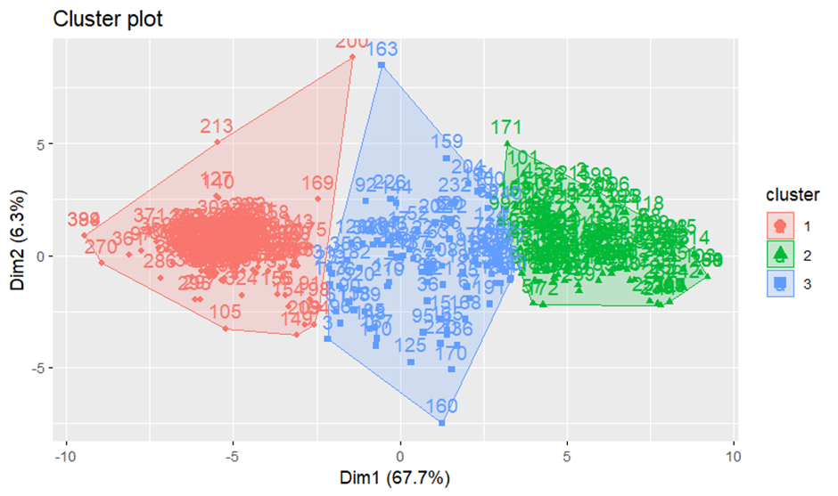

Slide 23

Cluster Characteristics
Cluster 1: Low Satisfaction
Cluster 2: High Satisfaction
Cluster 1, the largest segment comprising 42% of passengers, exhibits notably low satisfaction scores across a range of airline service attributes. This group expresses dissatisfaction with aspects such as waiting times during check-in and in-flight entertainment, indicating areas for immediate improvement.
Cluster 2, consisting of 38% of passengers, demonstrates moderate to high levels of satisfaction across various service attributes. This segment rates significantly higher compared to the other clusters, reflecting overall positive experiences with airline services, particularly in areas like cabin cleanliness and staff communication.
Cluster 3: Moderate Satisfaction
Cluster 3, comprising 20% of passengers, exhibits moderate satisfaction scores across various airline service attributes. While not as dissatisfied as Cluster 1, this segment presents an opportunity for targeted improvements in areas such as ease of getting tickets and communication skills of staff.

Slide 24




Tailored Service Enhancements
Identify Pain Points
Leverage Strengths
Implement Targeted Improvements
Airlines should prioritize addressing the specific pain points and areas of dissatisfaction identified within each passenger cluster. For Cluster 1, this may involve reducing waiting times during check-in and enhancing in-flight entertainment to elevate overall satisfaction levels.
By leveraging the strengths highlighted by Cluster 2, such as cabin cleanliness and effective staff communication, airlines can reinforce positive experiences and differentiate themselves in the competitive landscape, fostering greater brand loyalty within this valuable customer segment.
For Cluster 3, implementing targeted improvements based on customer feedback is crucial to meeting evolving passenger preferences and maintaining high levels of satisfaction. Addressing areas like ease of getting tickets and staff communication skills can help elevate the overall experience for this segment.

Slide 25


Competitive Advantage through Customer-Centricity
Segmented Strategies
Exceptional Experiences
Data-Driven Decisions
By adopting a segmented approach based on the distinct passenger clusters, airlines can effectively address varying levels of satisfaction and tailor their strategies to meet the specific needs and preferences of each group.
Consistently delivering exceptional experiences tailored to the unique needs of each passenger cluster can strengthen brand loyalty, attract new customers, and ultimately enhance the airline's market position and profitability.
The insights gained from cluster analysis empower airlines to make data-driven decisions, optimizing service delivery and resource allocation based on a deep understanding of customer preferences and behaviors.

Slide 26
Conclusion: Soaring to New Heights
Key Takeaway
By understanding and addressing the diverse satisfaction levels and preferences of passenger clusters, airlines can optimize service delivery, drive customer satisfaction, and ultimately enhance their market position and profitability.
Competitive Edge
Implementing customer-centric strategies based on cluster analysis insights can provide airlines with a significant competitive edge in the industry, enabling them to differentiate their offerings and foster long-term customer loyalty.
Continuous Improvement
As customer preferences and market dynamics evolve, airlines should continuously monitor and analyze passenger data, refining their cluster analysis and adapting their strategies to maintain a customer-centric approach and stay ahead of the competition.

Slide 27


Passenger Loyalty Insights: Decision Tree Analysis in Indian Aviation
This chapter explores factors influencing passenger loyalty in Indian aviation. Through decision tree analysis, we aim to uncover hidden patterns and insights into passenger preferences and satisfaction.

Slide 28

Data Collection
1
Survey
A structured survey captured service quality variables from 440 passengers in Indian domestic aviation.
2
Software
IBM SPSS was utilized for decision tree analysis using CHAID and CRT methods.
3
Interpretation
Decision tree models were analyzed to identify key predictors and decision rules influencing passenger loyalty.

Slide 29

Data Preparation
Data Collection
1
Survey data was collected from 440 respondents and imported into SPSS as an Excel file.
2
Data Cleaning
The data was cleaned, organized, recoded and transformed in SPSS.
Variable Selection
3
Variables positively correlated with the dependent variables were selected as independent variables.

Slide 30
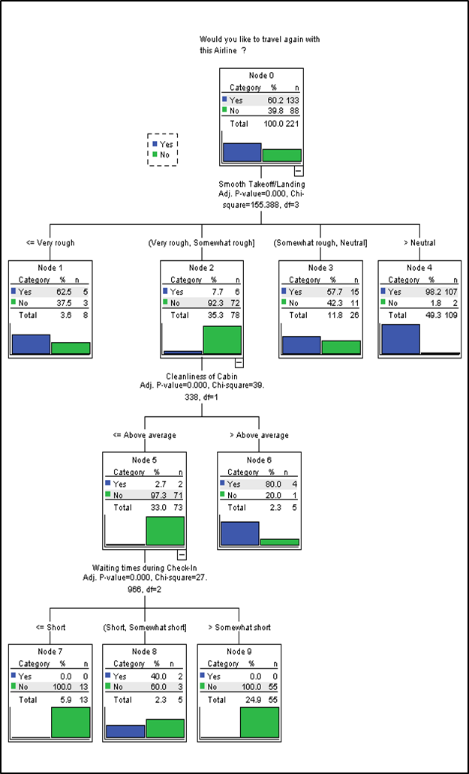
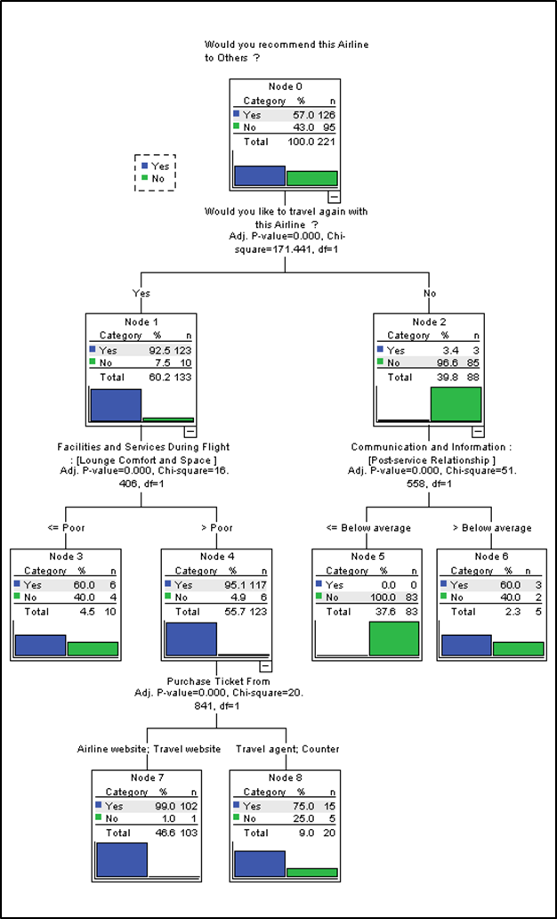
Normal Approach Analysis
Travel Again
Recommend Airline
Smooth take-off/landing and cabin cleanliness were most important for likelihood to travel again.
Willingness to travel again and lounge comfort/space were key factors for recommending the airline.

Slide 31




Correlation-Based Approach
Variable Selection
Travel Again
Recommend Airline
Variables positively correlated with dependent variables were selected as independent variables.
Choice decided by and age were most important for likelihood to travel again.
Willingness to travel again was the primary factor for recommending the airline.

Slide 32



Methodology
Decision Trees
Correlation Analysis
Data Split
CHAID and CRT decision trees were used as growing methods.
Spearman's Rho correlation was used to select independent variables.
The data was split into training and test sets for model evaluation.

Slide 33
Decision Tree Models
Travel Again
Recommend Airline
The decision tree model for "Would you like to travel again?" achieved 91.2% accuracy on the training set and 90% on the test set.
The model for "Would you recommend this airline?" had 94.1% training accuracy and 95% test accuracy.
"Choice decided by" and "Age" were the most important factors influencing likelihood to travel again.
The key factor was "Would you like to travel again?", highlighting the importance of customer satisfaction.

Slide 34
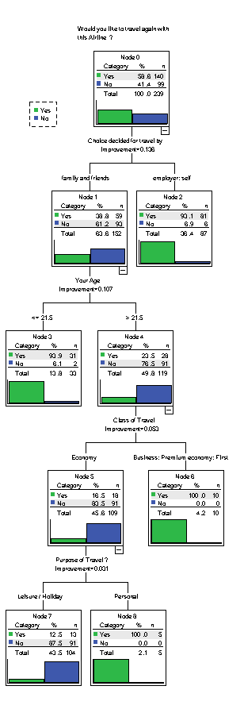
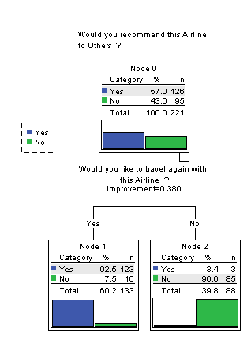

Slide 35
Model Performance
Model
Training Accuracy
Test Accuracy
Travel Again
91.2%
90%
Recommend Airline
94.1%
95%
The decision tree models demonstrated high accuracy on both training and test data, indicating good generalization ability and reliable predictions.

Slide 36

Key Findings
1
Travel Choice
2
Age Factor
Customers whose travel choice was decided by an employer or themselves were most likely to travel again.
Customers above 21 years old were least likely to travel again with Indian domestic airlines.
3
Recommendation Driver
Willingness to travel again was the primary driver for recommending the airline to others.

Slide 37
Key Insights
1
Smooth Operations
2
Cabin Cleanliness
Maintain consistent smoothness during take-off and landing to improve passenger satisfaction.
Improve and maintain high standards of cleanliness throughout the cabin.
3
Lounge Experience
4
Staff Training
Enhance lounge comfort and space to encourage positive recommendations.
Invest in staff training to improve friendliness and post-service relationships.

Slide 38

Limitations
Sample Size
Variable Selection
Accuracy may be affected by the sample size of the survey.
The choice of variables can impact the interpretability of the models.
Variable Interactions
Decision trees assume independence between variables, which may not always hold true.

Slide 39


Conclusion
Optimize Service
Foster Loyalty
Encourage Advocacy
Airlines can tailor offerings based on insights to enhance passenger experiences.
Understanding preferences allows airlines to build lasting relationships with passengers.
Satisfied passengers are more likely to recommend airlines to others.

Slide 40
Future Outlook
Continuous Improvement
Leverage insights to refine and enhance service quality continuously.
Personalization
Tailor offerings based on passenger segments and preferences.
Innovation
Explore new technologies and strategies to stay ahead of the competition.
Sustainability
Prioritize eco-friendly practices to meet evolving passenger expectations.

Slide 41

Conclusion
The decision tree analysis provided valuable insights into the factors influencing passenger loyalty in the Indian domestic aviation sector. The findings can guide airlines in tailoring their strategies to enhance customer satisfaction and retention, ultimately driving growth and profitability.

Slide 42

Logistic Regression: Analyzing Passenger Behavior in Indian Airlines
In the dynamic and competitive landscape of the airline industry, understanding passenger behavior and the factors influencing their decision to travel again is crucial for airlines striving to maintain a loyal customer base and sustainable profitability. This chapter presents an in-depth analysis of passenger experience in Indian airlines using binary logistic regression, investigating the probability of passengers choosing to travel again and the effects of socio-economic and demographic factors on this probability.

Slide 43
Introduction to Logistic Regression
Logistic regression is a statistical analysis technique used to model the relationship between a binary dependent variable and one or more independent variables. The purpose of logistic regression is to estimate the probability of occurrence of the dependent variable given a set of independent variables. In this study, binary logistic regression was used to identify which variables have a significant effect on the binary dependent variable, "Would you like to travel again with this Airline?", and thereby identify the risk factors influencing passenger choice.
Logit
1
The formula for the regression model is expressed in terms of the logit, which is the natural logarithm of the odds of the outcome occurring. The coefficients in logistic regression represent the change in the log odds of the outcome for a one-unit change in the corresponding independent variable, holding all other variables constant.
2
Odds Ratio
An odds ratio greater than 1 means the independent variable increases the odds of the event occurring, while an odds ratio less than 1 means the independent variable decreases the odds of the event occurring.
Applications
3
Logistic regression is widely used in various fields such as finance, healthcare, marketing, and more, where binary classification tasks are common.

Slide 44










Variables and Software Utilization
In this study, the dependent variable was "Likeness to travel again," while the following independent variables were included. and Purchase Ticket From. These variables were selected based on their relevance to the objectives of the study and their potential to influence a passenger's choice to travel again.
Gender
Profession
Monthly Income
Frequency of Travel
Residential Status
Male or Female
Public, Private, Government, Business, or Others
Less than Rs. 50,000, Rs. 50,000 – 1 Lakh, Rs. 1-2 Lakh, Rs. 2-3 Lakh, or More than Rs. 3 Lakh
Very Frequently, Frequently, Occasionally, or Rarely
Own, Rent or Others
Highest Qualification
Choice of Travel Decided by
Purchase Ticket From
Purpose of Travel
Class of Travel
Secondary, Higher Secondary, Bachelor’s, Master’s, Doctorate, Professional or Others
Airline Website, Travel Website, Counter or Travel Agent
Personal, Business or Leisure
Economy, Premium Economy, Business or First
Self, Family &Friends or Employer

Slide 45
Results and Interpretation
The results of the binary logistic regression analysis revealed several significant findings. The overall percentage of observations correctly classified by the model was 90.5%, indicating a good fit. The Hosmer and Lemeshow Goodness of Fit test also confirmed that the model fit was good.
Background Characteristics
Estimate (B)
Odds Ratio (Exp(B))
Gender: Male
-0.667
0.513
Profession: Business
-1.782
0.168
Monthly Income: Rs. 2-3 Lakh
-3.522
0.030
Residential Status: Own
-2.171
0.114
Frequency of Travel: Rarely
-1.698
0.183
Class: Economy
-3.106
0.045
Choice decided for travel by: Self
3.006
20.199

Slide 46

Logistic Regression Model
The study employed binary logistic regression analysis using IBM SPSS software to model the relationship between the independent variables and the likelihood of a passenger choosing to travel again. The resulting logistic model is presented below:
ln ( p / (1 - p) ) = -0.33 - 0.667[MALE] - 1.204[PUBLIC] - 1.782[BUSINESS] - 3.522[RS. 2-3 LAKH] - 2.171[OWN] - 1.698[RARELY] - 3.106[ECONOMY] + 3.006[SELF]
This model allows for the calculation of the odds ratio (OR) for each independent variable, providing insights into the factors that influence a passenger's decision to travel again.

Slide 47
Odds Ratio Calculation
The odds ratio (OR) for the logistic regression model can be calculated using the following equation:
OR = exp(-0.33 - 0.667[MALE] - 1.204[PUBLIC] - 1.782[BUSINESS] - 3.522[RS. 2-3 LAKH] - 2.171[OWN] - 1.698[RARELY] - 3.106[ECONOMY] + 3.006[SELF])
The odds ratio provides a measure of the association between each independent variable and the likelihood of a passenger choosing to travel again. Variables with an odds ratio greater than 1 are associated with an increased likelihood, while those with an odds ratio less than 1 are associated with a decreased likelihood.

Slide 48




Key Findings and Implications
Gender and Profession
Income and Residential Status
Travel Frequency and Class
Choice for Travel
The odds of travelling again were lower for male passengers and those in the business profession, suggesting that airlines should tailor their services and marketing strategies to better cater to these segments.
Passengers who decided to travel by themselves were significantly more likely to travel again, suggesting that airlines should focus on empowering passengers and providing them with greater control over their travel experiences.
Passengers with a monthly income between Rs. 2-3 Lakh and those who own their residences were less likely to travel again, indicating potential areas for improvement in service quality and value proposition.
Passengers who travelled rarely and those who travelled in the economy class were less likely to choose to travel again, highlighting the need for airlines to enhance the overall experience for these segments.

Slide 49
Conclusion and Future Directions
This study has provided valuable insights into the factors influencing passenger choice to travel again with Indian airlines. By identifying the significant socio-economic and demographic characteristics that impact this decision, airlines can develop targeted strategies to enhance passenger satisfaction, loyalty, and overall experience.
Personalization
Experience Enhancement
Tailor services and marketing strategies to specific passenger segments based on their socio-economic and demographic characteristics.
Improve the overall travel experience for segments with lower likelihood of travelling again, such as economy class passengers and those who travel rarely.
Empowerment
Continuous Improvement
Empower passengers by providing them with greater control and choice over their travel experiences, as passengers who decided to travel by themselves were more likely to travel again.
Continuously monitor and adapt strategies based on changing passenger preferences and behavior through ongoing research and analysis.

Slide 50

Sentiment Analysis of Airline Passengers
In an effort to understand the overall emotion and satisfaction of passengers travelling with Indian Airlines, a study was conducted that included an open-ended question asking for "Any additional comments or suggestions". This allowed respondents to freely share their travel experiences. The responses to this question were then analyzed using sentiment analysis techniques to gauge the overall sentiment and tone.

Slide 51
Sentiment Analysis
Data Collection
1
Collect textual data like customer reviews, social media posts, etc.
2
Pre-processing
Clean and standardize data by removing irrelevant info, tokenizing, and stemming.
Analysis
3
Convert text using techniques like bag-of-words, train models on labeled data.
4
Prediction
Model predicts sentiment (positive, negative, neutral) on new data.

Slide 52



Results
Sentiment Score
Interpretation
The sentiment analysis of the additional comments provided by passengers yielded a sentiment score of 39.8 on a scale ranging from -100 to +100.
A score of -100 indicates a very negative or serious tone, while a score of +100 indicates a very positive or enthusiastic tone. Therefore, a score of 39.8 suggests that the overall sentiment or tone of the comments is somewhat positive or enthusiastic.

Slide 53

Conclusion
Positive Experience
Continuous Improvement
Competitive Advantage
The sentiment analysis results indicate that the overall experience of passengers travelling with Indian Airlines is positive, with a sentiment score of 39.8 on a scale of -100 to +100.
However, the airline should continue to analyze and address specific feedback from passengers to further improve their services and maintain a high level of customer satisfaction.
By consistently delivering a positive travel experience and addressing customer concerns, Indian Airlines can gain a competitive advantage in the airline industry and foster customer loyalty.

Slide 54
RECOMMENDATIONS
- Tailoring marketing strategies and service offerings to different customer segments.
- Addressing key factors influencing passenger satisfaction and loyalty, such as flight smoothness, cleanliness, and staff friendliness.
- Monitoring passenger feedback continuously and implementing timely improvements to enhance overall service quality.
- Investing in staff training programs to ensure consistent delivery of exceptional customer experiences.

Slide 55
Bibliography
Sandeep Walia, Dharminder Sharma & Amit Mathur (2021). The Impact of Service Quality on Passenger Satisfaction and Loyalty in the Indian Aviation Industry. International Journal of Hospitality & Tourism Systems
2. Waqas Niazi, Jamal A. Farooqui (2020). Quality of airline services in India: A customers’ perspective. PIMT Journal of Research, Volume-12, No.-2
3. Colin C.H. Law, Yahua Zhang & Jeff Gow (2022). Airline service quality, customer satisfaction, and repurchase Intention: Laotian air passengers’ perspective. Case Studies on Transport Policy, Volume-10, Issue-2
4. Bhandare, Bharat C (2006). Air transport: A comparative study of Air India with other international airlines. Savitribai Phule Pune University.
5. Bharti Seth (2023). Analysis Study of The Indian Airline Sector Using Data Envelopment Analysis. Indira Gandhi Delhi Technical University for Women
6. Mayur Wankhade, Annavarapu Chandra Sekhara Rao & Chaitanya Kulkarni (2022). A survey on sentiment analysis methods, applications, and challenges.
7. Rangsan Nochai & Titida Nochai (2018). Applying Logistic Regression Analysis to Determine the Service Quality Factors Affecting on Consumer Satisfaction Toward Domestic Low-Cost Airlines in Thailand. The International Academic Forum

